Slide 1
Three branches of classical philosophy
after Aristotle
Stoicism
Epicureanism
Neo-Platonism

Slide 2
Stoicism
This tradition began when one of its founders, Zeno of Citium (334-262 BCE) was not allowed to play with the popular kids in Plato’s Academy. They told him his ideas were too weird, and invited him to leave.
So he decided to teach his students in front of one of the public monuments in the Agora of Athens, a building which had a covered outdoor porch - the Stoa Poikile - which was open to the public but also sheltered from sun and wind and rain.
The Stoic tradition got its name from this building.

Slide 3
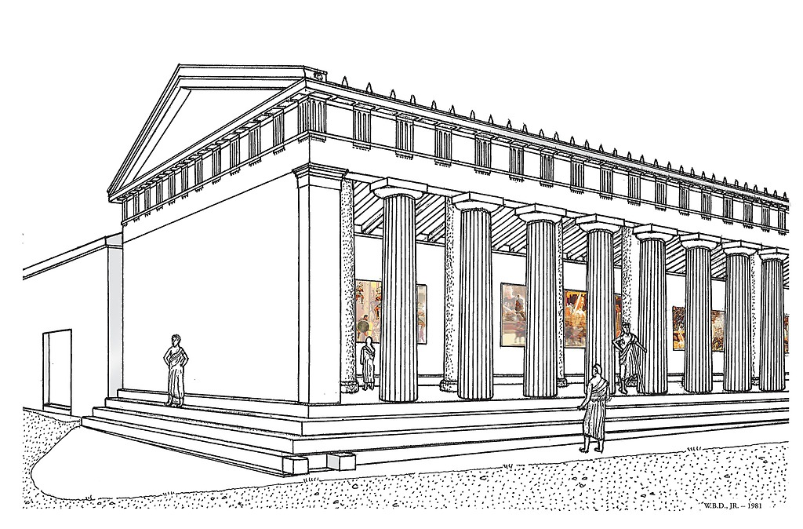

Slide 4
Stoicism begins with a premise similar to the one that Aristotle began with: what we all ultimately want is to lead a fulfilling, worthwhile life.
Then the argument asks the practitioner to face the world honestly, and also to face one’s own position in the world honestly.
And from this direct look at things, the Stoic draws an important conclusion: there’s really nothing you can do about a lot of what’s going on in the world. You just have to accept that certain events will affect you which you cannot avoid or change.
For this reason, perhaps, the word Stoicism has today come to mean something like unemotional, indifferent fortitude, or even resignation, in the face of bad fortune.

Slide 5
But this impression is only half-right; stoicism does not teach that the emotions are bad, but it does teach that there’s no point getting upset or afraid of that which you can neither affect nor avoid.
Stoicism teaches that we are all responsible for our own happiness: we cannot blame our circumstances or surroundings for how we feel.
As Epictetus wrote, “It is not the things themselves which disturb men, but their judgments about these things.” (Epictetus, Enchiridion, §5)

Slide 6
Even in the face of tragic loss such as death, one should preserve a state of mental equanimity.
Marcus Aurelius wrote “Do not despise death: welcome it, rather, as one further part of nature’s will.” (Meditations 9.3)
And similarly, Epictetus wrote: “Never say about anything, ‘I have lost it’, but only ‘I have given it back.’ Is your child dead? It has been given back. Is your wife dead? She has been given back...” (Enchiridion §11)

Slide 7
Being responsible for our own happiness, therefore you should concern yourself with what is within your range of realistic choices.
If you make it your will that your children and your wife and your friends should live forever, you are silly; for you are making it your will that things not under your control should be under your control, and that what is not your own should be your own... If, however, it is your will not to fail in what you desire, this is in your power. Wherefore, exercise yourself in that which is in your power. Each man’s master is the person who has the authority over what the man wishes or does not wish, so as to secure it, or take it away. Whoever, therefore, wants to be free, let him neither wish for anything, nor avoid anything, that is under the control of others; or else he is necessarily a slave.
(Enchiridion §14)

Slide 8
A prominent Stoic metaphysical teaching is that the world is an organic whole: unified, inter-connected, and one. When Epictetus speaks of lost things as ‘given back’, it is to this organic whole they are given. This wholeness is mainly a matter of all things having the same nature, that is, the same inner order and constitution:
“there is one universe out of all things, one god pervading all things, one substance, one law, one common reason [logos] in all intelligent beings...” (Meditations 7.9)

Slide 9
Although this idea was sometimes pursued by Stoics for its own sake, it also served as a support for Stoic moral teachings:
Whether atoms or a natural order, the first premise must be that I am part of the Whole which is governed by nature; the second, that I have some close relationship with other kindred parts. With these premises in mind, in so far as I am a part I shall not resent anything assigned by the Whole. Nothing which benefits the Whole can be harmful to the part, and the Whole contains nothing which is not to its benefit... So remembering that I am part of a Whole so constituted will leave me happy with all that happens to me.
(Meditations 10.6)
The idea here, so it seems to me, is not only to make a point about the nature of the world. It is also to give people confidence. It is a way of saying that in the grand scheme of things, or ‘under a certain aspect of eternity’ (as Spinoza would say), all is well, and all things are working themselves out for the best.

Slide 10
The Stoics had a word for this confidence: apatheia, which could be translated as ‘without passion’, in the sense of being without worry, fear, or distress.
In the mind of one who is chastened and cleansed [i.e. one who has achieved apatheia] you will find no suppuration, no simmering ulcer, no sore festering under the skin. Fate does not catch him with his life unfulfilled, as one might speak of an actor leaving the stage before his part is finished...
(Meditations 3.8)

Slide 11
This might look rather cold and dispassionate. But apatheia does not require us to purge or suppress our emotions.
Rather it requires us to “live each day as if it were your last, without frenzy, without apathy, without pretence.” (Meditations §7.69), or as we might say today, to ‘live in the moment’.
Thus apatheia can be seen as a kind of enlightenment; certainly the Stoics of the ancient world would have seen it as a kind of freedom.

Slide 12
Here’s a few more selections from the Meditations.
Whatever it is, this being of mine is made up of flesh, breath, and directing mind. Now the flesh you should disdain— blood, bones, a mere fabric and network of nerves, veins, and arteries. Consider too what breath is: wind— and not even a constant, but all the time being disgorged and sucked in again. That leaves the third part, the directing mind. Quit your books- no more hankering: this is not your gift. No, think like this, as if you were on the point of death: ‘you are old; don’t then let this directing mind of yours be enslaved any longer— no more jerking to the strings of selfish impulse, no more disquiet at your present or suspicion of your future fate.
2:2

Slide 13
Never regard as a benefit to yourself anything which will force you at some point to break your faith, to leave integrity behind, to hate, suspect, or curse another, to dissemble, to covet anything needing the secrecy of walls and drapes. A man who has put first his own mind and divinity, and worships the supremacy of the god within him, makes no drama of his life, no hand-wringing, no craving for solitude or crowds, most of all, his life will be a life of neither pursuit nor avoidance, and it is of no remote concern to him whether he will retain the bodily envelope of his soul for a longer or a shorter time.
3:7

Slide 14
The empty pomp of a procession, plays on stage, flocks and herds, jousting shows, a bone thrown to puppies, tit-bits into the fishponds, ants toiling and carrying, the scurries of frightened mice, puppets dancing on their strings. Well, amid all of this you must keep yourself tolerant— do not snort at them. But bear in mind that a person’s worth is measured by the worth of what he values.
7:3

Slide 15
Whatever anyone does or says, I must be a good man. It is as if an emerald, or gold or purple, were always saying: ‘Whatever anyone does or says, I must be an emerald and keep my own colour.’
7:15

Slide 16
The sinner sins against himself: the wrongdoer wrongs himself, by making himself bad.
9:4

Slide 17
Whether atoms or a natural order, the first premise must be that I am part of the Whole which is governed by nature; the second, that I have some close relationship with the other kindred parts. With these premises in mind, in so far as I am a part I shall not resent anything assigned by the Whole. Nothing which benefits the Whole can be harmful to the part, and the Whole contains nothing which is not to its benefit…
So remembering that I am part of a Whole so constituted will leave me happy with all that happens to me.
10:6

Slide 18
Here’s a few selections from On the Shortness of Life, by Seneca the Younger (4BCE-65CE)
§ I.
The majority of mortals, Paulinus,1 complain bitterly of the spitefulness of Nature, because we are born for a brief span of life, because even this space that has been granted to us rushes by so speedily and so swiftly that all save a very few find life at an end just when they are getting ready to live. Nor is it merely the common herd and the unthinking crowd that bemoan what is, as men deem it, an universal ill; the same feeling has called forth complaint also from men who were famous. It was this that made the greatest of physicians exclaim that "life is short, art is long;" it was this that led Aristotle, while expostulating with Nature, to enter an indictment most unbecoming to a wise man—that, in point of age, she has shown such favour to animals that they drag out five or ten lifetimes, but that a much shorter limit is fixed for man, though he is born for so many and such great achievements. It is not that we have a short space of time, but that we waste much of it. Life is long enough, and it has been given in sufficiently generous measure to allow the accomplishment of the very greatest things if the whole of it is well invested. But when it is squandered in luxury and carelessness, when it is devoted to no good end, forced at last by the ultimate necessity we perceive that it has passed away before we were aware that it was passing. So it is—the life we receive is not short, but we make it so, nor do we have any lack of it, but are wasteful of it.

Slide 19
§ XI
In a word, do you want to know how they do not "live long"? See how eager they are to live long! Decrepit old men beg in their prayers for the addition of a few more years; they pretend that they are younger than they are; they comfort themselves with a falsehood, and are as pleased to deceive themselves as if they deceived Fate at the same time. But when at last some infirmity has reminded them of their mortality, in what terror do they die, feeling that they are being dragged out of life, and not merely leaving it. They cry out that they have been fools, because they have not really lived, and that they will live henceforth in leisure if only they escape from this illness; then at last they reflect how uselessly they have striven for things which they did not enjoy, and how all their toil has gone for nothing. But for those whose life is passed remote from all business, why should it not be ample? None of it is assigned to another, none of it is scattered in this direction and that, none of it is committed to Fortune, none of it perishes from neglect, none is subtracted by wasteful giving, none of it is unused; the whole of it, so to speak, yields income. And so, however small the amount of it, it is abundantly sufficient, and therefore, whenever his last day shall come, the wise man will not hesitate to go to meet death with steady step.

Slide 20
§ XIV.
Of all men they alone are at leisure who take time for philosophy, they alone really live; for they are not content to be good guardians of their own lifetime only. They annex ever age to their own; all the years that have gone ore them are an addition to their store. Unless we are most ungrateful, all those men, glorious fashioners of holy thoughts, were born for us; for us they have prepared a way of life…
But we may fairly say that they alone are engaged in the true duties of life who shall wish to have Zeno, Pythagoras, Democritus, and all the other high priests of liberal studies, and Aristotle and Theophrastus, as their most intimate friends every day. No one of these will be "not at home," no one of these will fail to have his visitor leave more happy and more devoted to himself than when he came, no one of these will allow anyone to leave him with empty hands; all mortals can meet with them by night or by day.

Slide 21
§ XV.
No one of these [aforementioned philosophers] will force you to die, but all will teach you how to die; no one of these will wear out your years, but each will add his own years to yours; conversations with no one of these will bring you peril, the friendship of none will endanger your life, the courting of none will tax your purse. From them you will take whatever you wish; it will be no fault of theirs if you do not draw the utmost that you can desire. What happiness, what a fair old age awaits him who has offered himself as a client to these! He will have friends from whom he may seek counsel on matters great and small, whom he may consult every day about himself, from whom he may hear truth without insult, praise without flattery, and after whose likeness he may fashion himself.

Slide 22
§ XVI.
But those who forget the past, neglect the present, and fear for the future have a life that is very brief and troubled; when they have reached the end of it, the poor wretches perceive too late that for such a long while they have been busied in doing nothing. Nor because they sometimes invoke death, have you any reason to think it any proof that they find life long. In their folly they are harassed by shifting emotions which rush them into the very things they dread; they often pray for death because they fear it…
All postponement of something they hope for seems long to them. Yet the time which they enjoy is short and swift, and it is made much shorter by their own fault; for they flee from one pleasure to another and cannot remain fixed in one desire. Their days are not long to them, but hateful; yet, on the other hand, how scanty seem the nights which they spend in the arms of a harlot or in wine! It is this also that accounts for the madness of poets in fostering human frailties by the tales in which they represent that Jupiter under the enticement of the pleasures of a lover doubled the length of the night. For what is it but to inflame our vices to inscribe the name of the gods as their sponsors, and to present the excused indulgence of divinity as an example to our own weakness? Can the nights which they pay for so dearly fail to seem all too short to these men? They lose the day in expectation of the night, and the night in fear of the dawn.

